Slide 1
Data Science: Tools and Techniques
Lecture No. 9
Fall 2024
National University of Computer and Emerging Sciences, Lahore

Slide 2
Introduction to Optimization
Outline
Introduction to Data Science
Data Science Workflow
Data Types and Structures
Data Collection and Preprocessing
Exploratory Data Analysis
Basic Statistics
Visualization Techniques
Identifying Trends

Slide 3
Introduction to Optimization
What is Data Science?
Data Science is the process of extracting knowledge and insights from data by using scientific methods.
Data Science is the application of computational and statistical techniques to address or gain insight into some problem in the real world.
Data Science = statistics + data processing + machine learning + scientific inquiry + visualization + business analytics + big data + …

Slide 4

Introduction to Optimization
What is Data Science?
To gain insights into data through computation, statistics, and visualization
Ref: Data Science: Hanspeter Pfister

Slide 5
What is Data Science?
What is Data Science?
New technology makes it possible to capture vast amounts of logging / sensor data.
Computing advances make it possible to analyze data on ever increasing scales.
Prominent role models (Google, Nate Silver, ...) have proven the power of modern data analytics.
Data Science: Steven Skiena

Slide 6
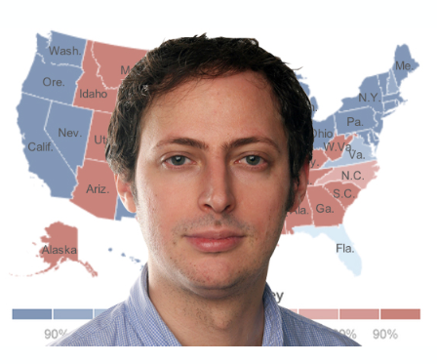
Introduction to Optimization
Nate Silver
American Data Scientist who analyzes elections and baseball.
-PECOTA: a system for forecasting the performance and career development of Major -League Baseball players.
- 2008 U.S. Presidential election
Sucessfully called the outcome of 49 of the 50 states.

Slide 7
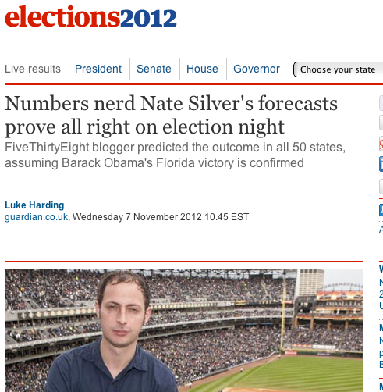
Why all the Excitement?

Slide 8
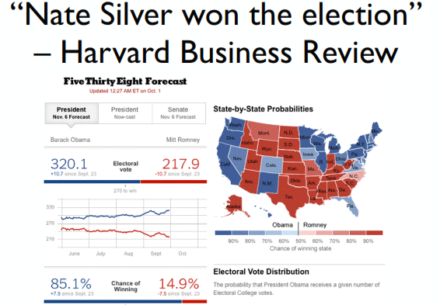
2012 U.S. Presidential election
  Correctly predicted the winners of all the states.

Slide 9
Introduction to Optimization
Some Key Principles
use many data sources
understand how the data were collected (sampling is essential)
weight the data thoughtfully (not all polls are equally good)
use statistical models (not just hacking around in Excel)
understand correlations (e.g., states that trend similarly)

Slide 10
Introduction to Optimization
Netflix Challenge
October 2006: Netflix offers $1M for an improved recommender algorithm.
Training data:
  100M ratings
  480K users
  17,770 movies
  6 years of data: 2000-2005
Test data:
  Last few ratings of each user (2.8M)
  Evaluation via RMSE: root mean squared error
  Netflix Cinematch RMSE: 0.9514
Competition:
  $1M grand prize for 10% improvement

Slide 11
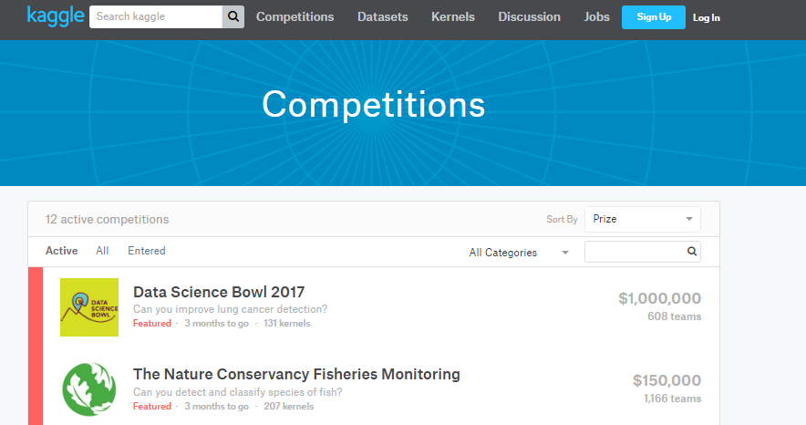
Introduction to Optimization
Kaggle

Slide 12
Introduction to Optimization
Why do we need Data Science?
Big Data
“Between the dawn of civilization and 2003, we only created ﬁve exabytes of information; now we’re creating that amount every two days.”
- Eric Schmidt, Google
Notes:
CEO from 2001 - 2011

Slide 13
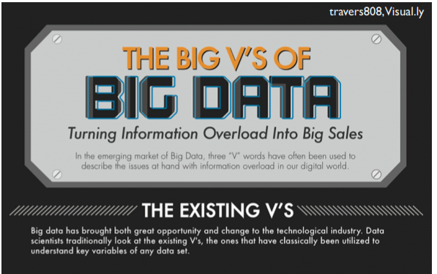
Introduction to Optimization
Why do we need Data Science?

Slide 14
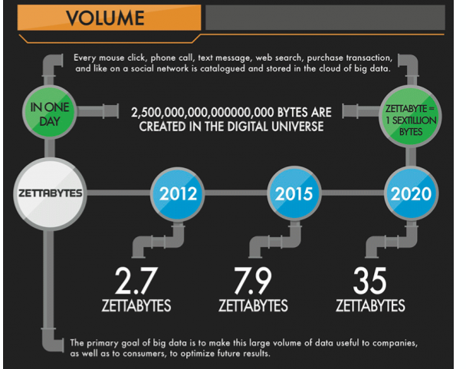
Introduction to Optimization
Why do we need Data Science?

Slide 15
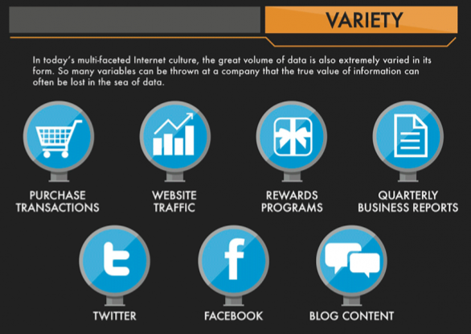
Introduction to Optimization
Why do we need Data Science?

Slide 16
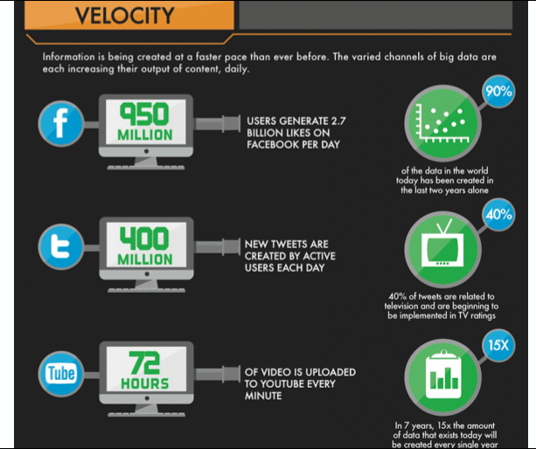
Introduction to Optimization
Why do we need Data Science?

Slide 17
Big Data – Vs of Data
Volume:
  How much data is really relevant to the problem solution? Cost of processing?
  So, can you really afford to store and process all that data?
Velocity:
  Much data coming in at high speed
  Need for streaming versus block approach to data analysis
  So, how to analyze data in-flight and combine with data at-rest
Variety:
  A small fraction is structured formats, Relational, XML, etc.
  A fair amount is semi-structured, as web logs, etc.
  The rest of the data is unstructured text, photographs, etc.
  So, no single data model can currently handle the diversity

Slide 18
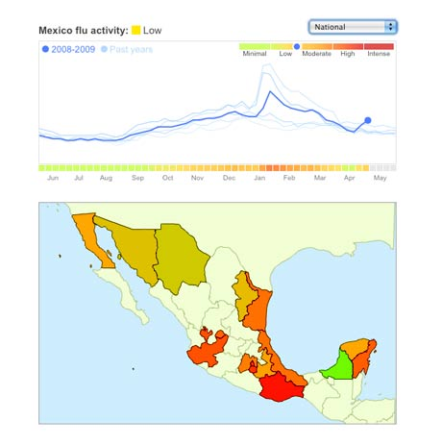
Data Science: Why all the Excitement?
e.g.,
Google Flu Trends:
Detecting outbreaks
two weeks ahead
of CDC data
(Contiguous Disease Control)
New models are estimating
which cities are most at risk
for spread of the Ebola virus.

Slide 19
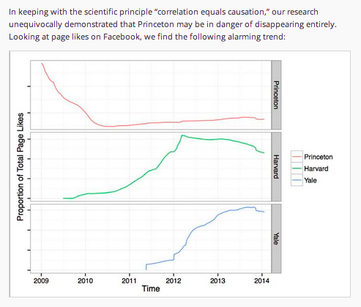
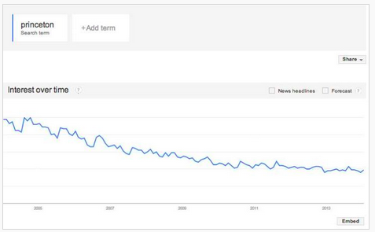
Data Makes Everything Clearer
and based on Princeton
search trends:
“This trend suggests that
Princeton will have only
half its current enrollment
by 2018, and by 2021 it will
have no students at all,…
http://techcrunch.com/2014/01/23/facebook-losing-users-princeton-losing-credibility/

Slide 20
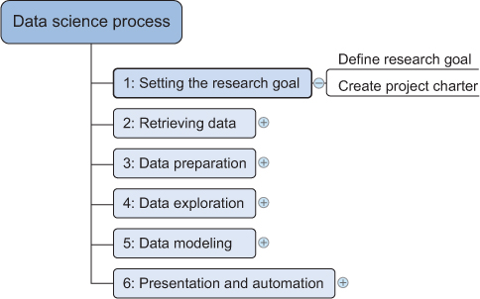
Data Science Workflow
The data science workflow is a structured process that guides data scientists in transforming raw data into actionable insights

Slide 21
Setting The research goal
A project starts by understanding the what, the why, and the how of your project
Answering these three questions (what, why, how) is the goal of the first phase, so that everybody knows what to do and can agree on the best course of action.

Slide 22
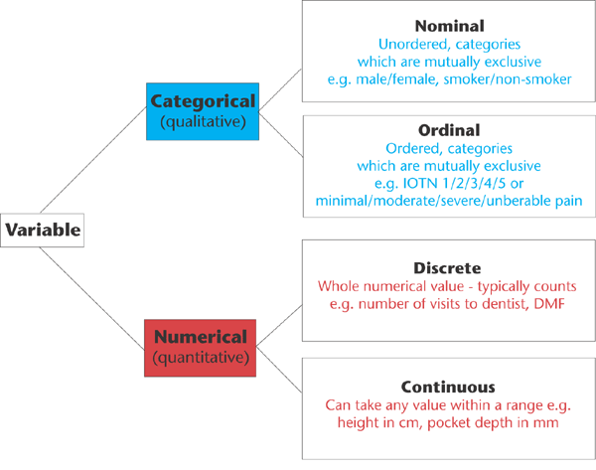
Stage 2: Retrieving Data
Data can be stored in many forms, ranging from simple text files to tables in a database.
The objective now is acquiring all the data you need.
This may be difficult, and even if you succeed, data is often like a diamond in the rough: it needs polishing to be of any use to you.

Slide 23
Step 3: Data Preparation
Step 3: Data Preparation- Data Cleansing
General solution: Try to fix the problem early in the data acquisition chain or else fix it in the program
Error description | Possible solution
Errors pointing to false values within one data set
Mistakes during data entry | Manual overrules
Redundant white space | Use string functions
Impossible values | Manual overrules
Missing values | Remove observation or value
Errors pointing to inconsistencies between data sets
Different units of measurement | Recalculate
Data Cleansing
Notes:
Data Entry Errors: Data collection and data entry are error-prone processes. They often require human intervention, and because humans are only human, they make typos or lose their concentration for a second and introduce an error into the chain.
if x == "Godo": x = "Good" if x == "Bade": x = "Bad“
2) Whitespaces tend to be hard to detect but cause errors like other redundant characters would. .strip()
3) Sanity checks are another valuable type of data check. Here you check the value against physically or theoretically impossible values such as people taller than 3 meters or someone with an age of 299 years. Sanity checks can be directly expressed with rules:
4) An outlier is an observation that seems to be distant from other observations or, more specifically, one observation that follows a different logic or generative process than the other observations. The easiest way to find outliers is to use a plot or a table with the minimum and maximum values
5) Missing values aren’t necessarily wrong, but you still need to handle them separately; certain modeling techniques can’t handle missing values. Age, avg (age)
6) Detecting errors in larger data sets against a code book or against standardized values can be done with the help of set operations. A code book is a description of your data, a form of metadata. It contains things such as the number of variables per observation, the number of observations, and what each encoding within a variable means. (For instance “0” equals “negative”, “5” stands for “very positive”.)
7) When integrating two data sets, you have to pay attention to their respective units of measurement. An example of this would be when you study the prices of gasoline in the world. To do this you gather data from different data providers. Data sets can contain prices per gallon and others can contain prices per liter. A simple conversion will do the trick in this case.
8) Having different levels of aggregation is similar to having different types of measurement. An example of this would be a data set containing data per week versus one containing data per work week. This type of error is generally easy to detect, and summarizing (or the inverse, expanding) the data sets will fix it.

Slide 24
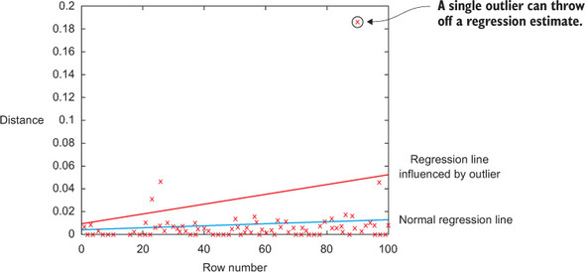

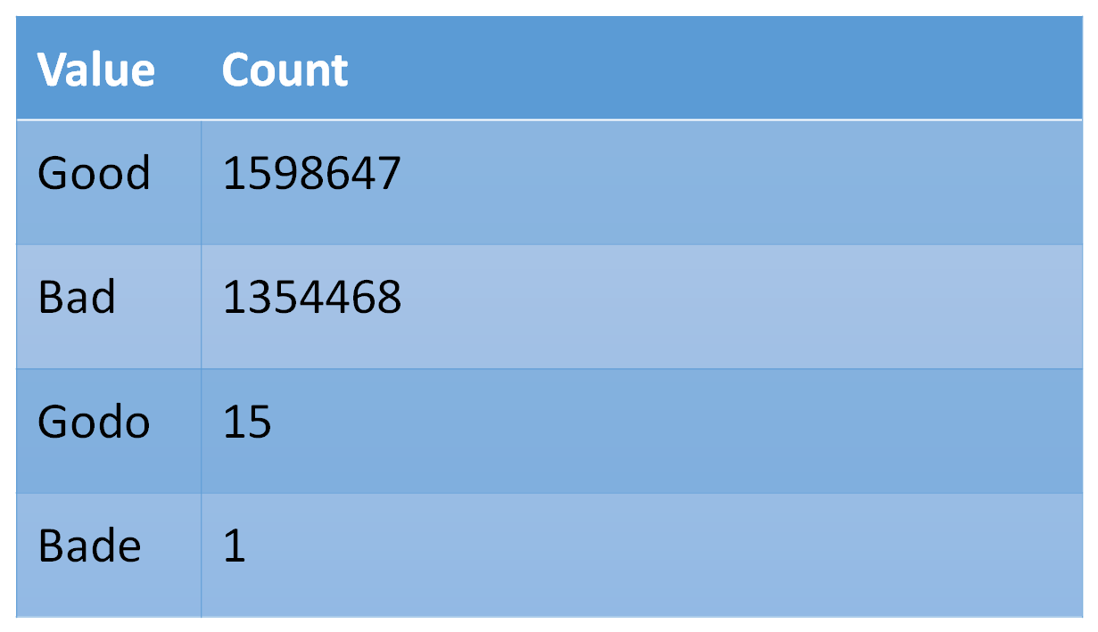
Outliers
Table 2.3. Detecting outliers on simple variables with a frequency table

Slide 25
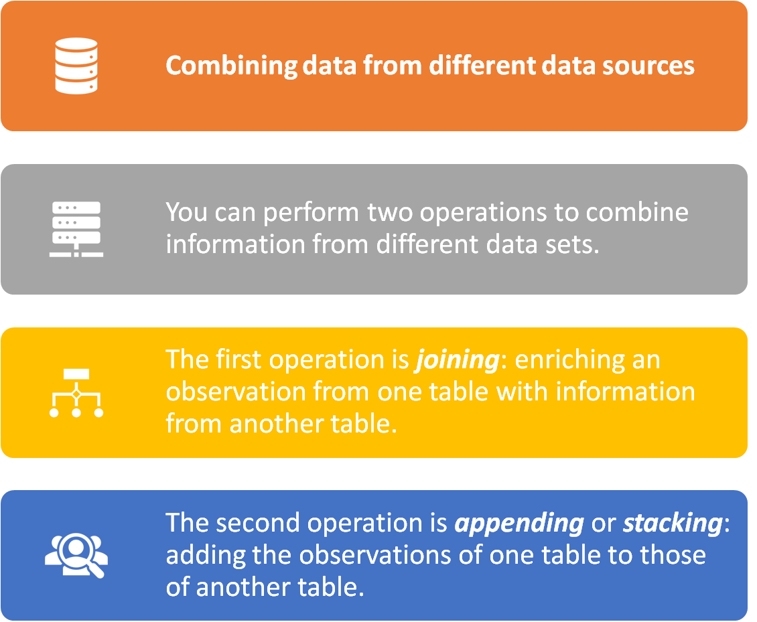
Step 3:
Cleansing, integrating, and transforming data

Slide 26
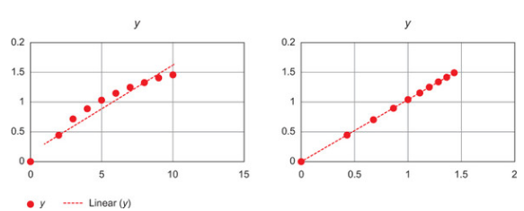
Step 3:
Cleansing, integrating, and transforming data
Transforming the Data
Certain models require their data to be in a certain shape.
Transforming your data so it takes a suitable form for data modeling.

Slide 27
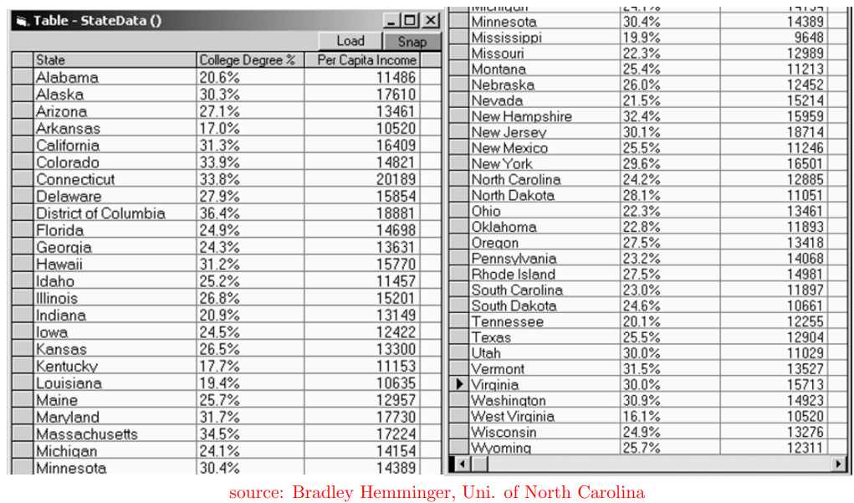
Step 4: Exploratory Analysis
Which state has the largest and the smallest College degree and Per Capita income?
Which states are outliers if any?
How is income related to college degree?

Slide 28
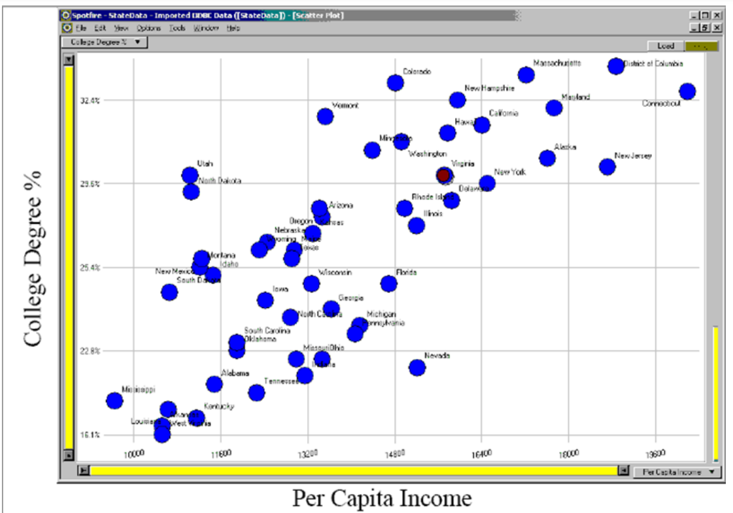
Can easily tell what is largest/smallest in every dimension

Slide 29
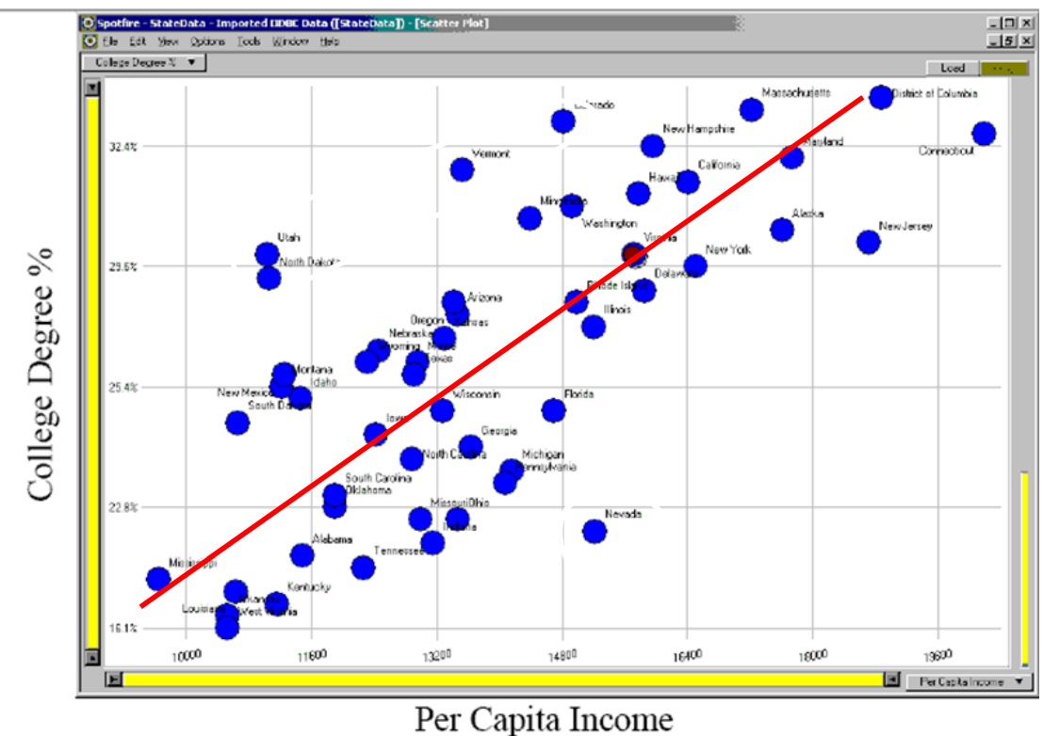
Visualization helps identify relationship easily as compared to raw data

Slide 30
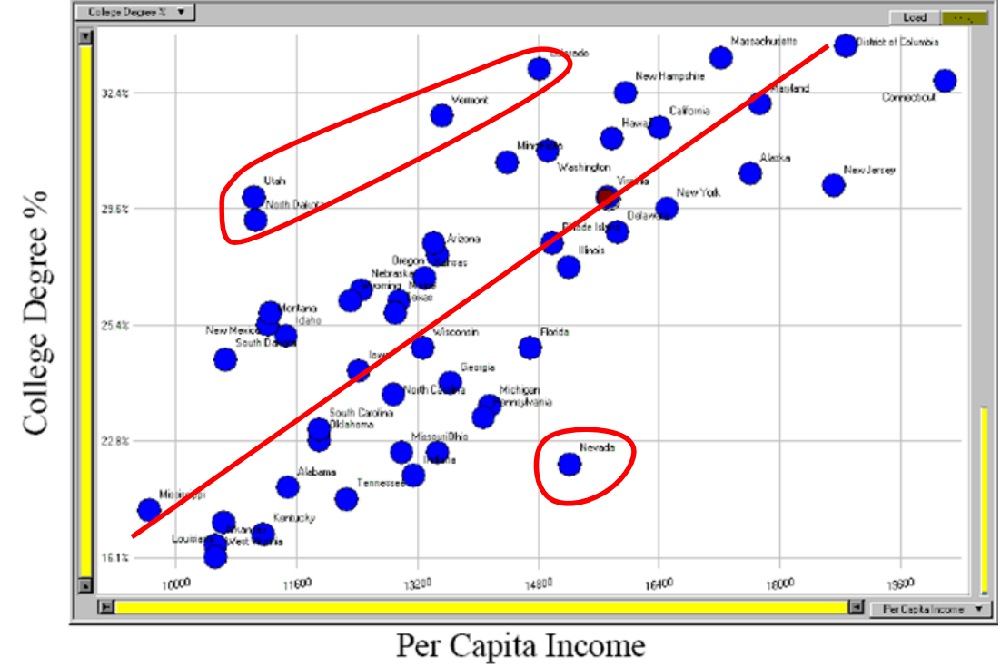
Outliers stand out and get identified easily

Slide 31
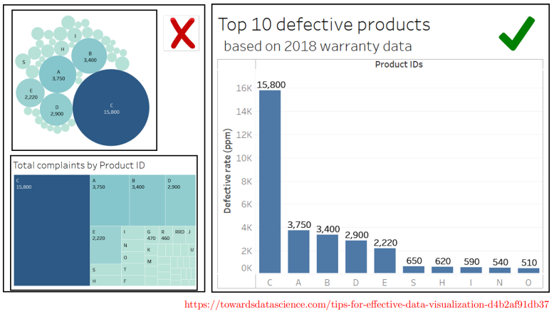
Chose right visuals, according to purpose

Slide 32
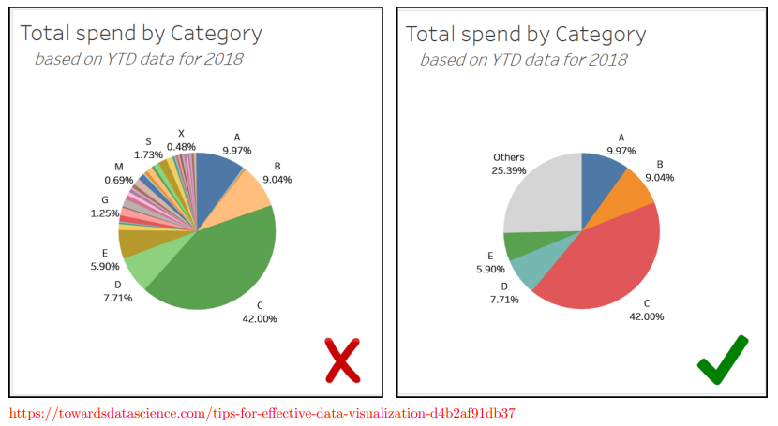
Suppress the noise

Slide 33
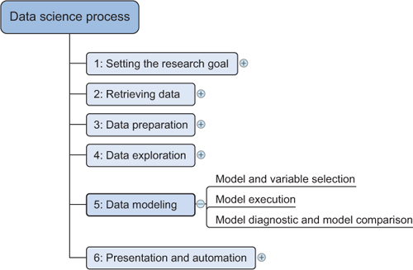
Model Building
Regression
Classification
Clustering
Will discuss them in next lecture

